Slide 1
Next week
1-on-1 interviews
CGI on an ice-free Arctic

Slide 2
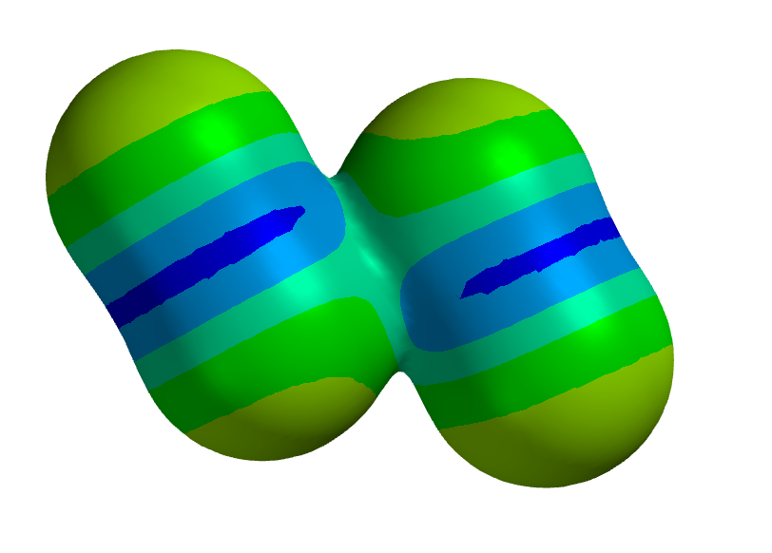
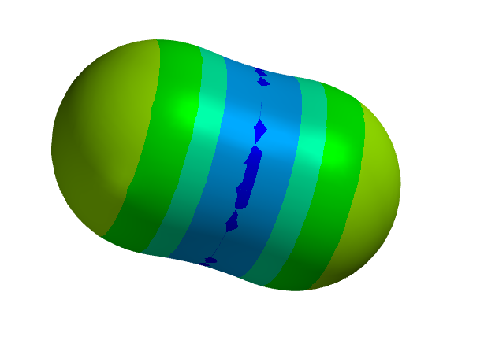
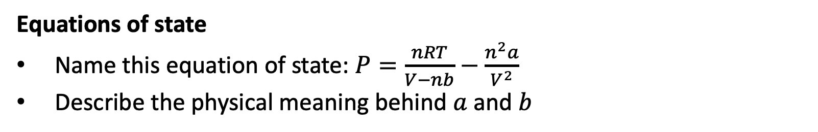
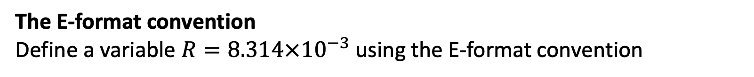
Week 1 (this is a sampler, not necessarily what I’ll ask you)
The E-format convention
Define a variable $R=8.314×{10}^{−3}$using the E-format convention
Intermolecular bond strengths
What do the colors mean in these electrostatic potential maps?
Equations of state
Name this equation of state: $P=\frac{nRT}{V−nb}−\frac{n^{2}a}{V^{2}}$
Describe the physical meaning behind $a$ and $b$

Slide 3
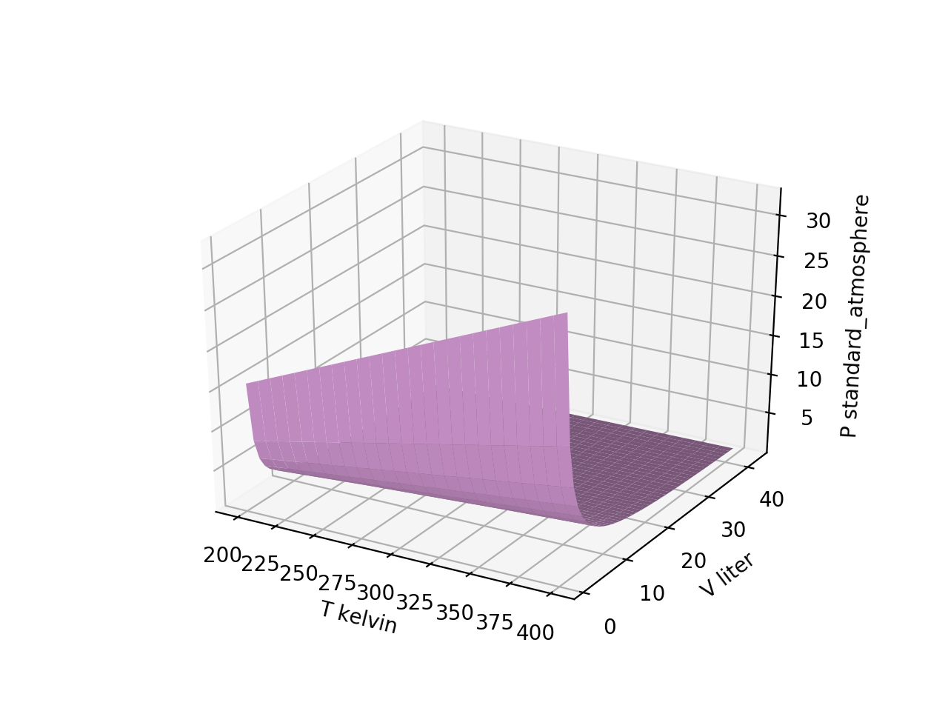
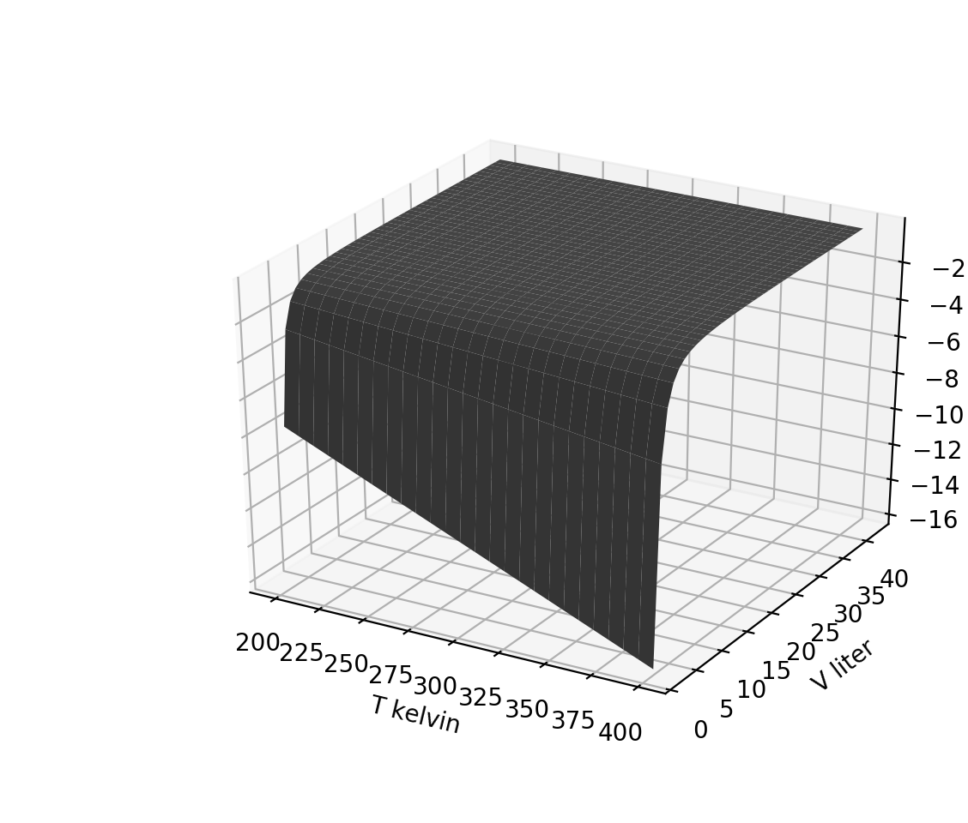
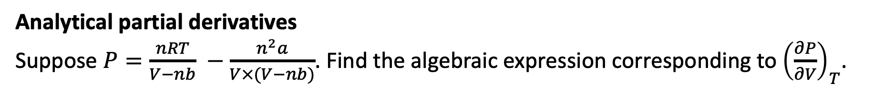
Week 2 (this is a sampler, not necessarily what I’ll ask you)
1. ${\left(\frac{∂P}{∂V}\right)}_{T}$
Visualizing derivative thermodynamic surfaces, part 1
Which thermodynamic surface is the one on the right?
$2. {\left(\frac{∂P}{∂T}\right)}_{V}$
${3. \left(\frac{∂T}{∂V}\right)}_{T}$
$$P(T,V)$$
${4. \left(\frac{∂T}{∂T}\right)}_{V}$
Analytical partial derivatives
Suppose $P=\frac{nRT}{V−nb} −\frac{n^{2}a}{V×(V−nb)}$. Find the algebraic expression corresponding to ${\left(\frac{∂P}{∂V}\right)}_{T}$.

Slide 4

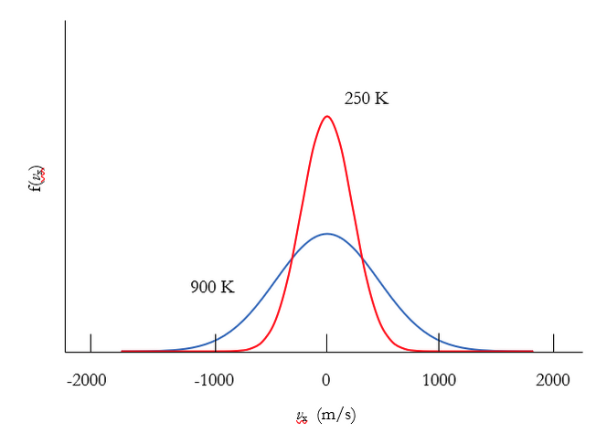
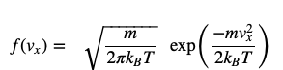
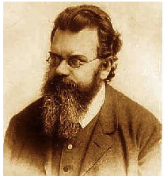
Week 3 (this is a sampler, not necessarily what I’ll ask you)
Probability densities
Which graph below corresponds to the heavier molecule?

Slide 5
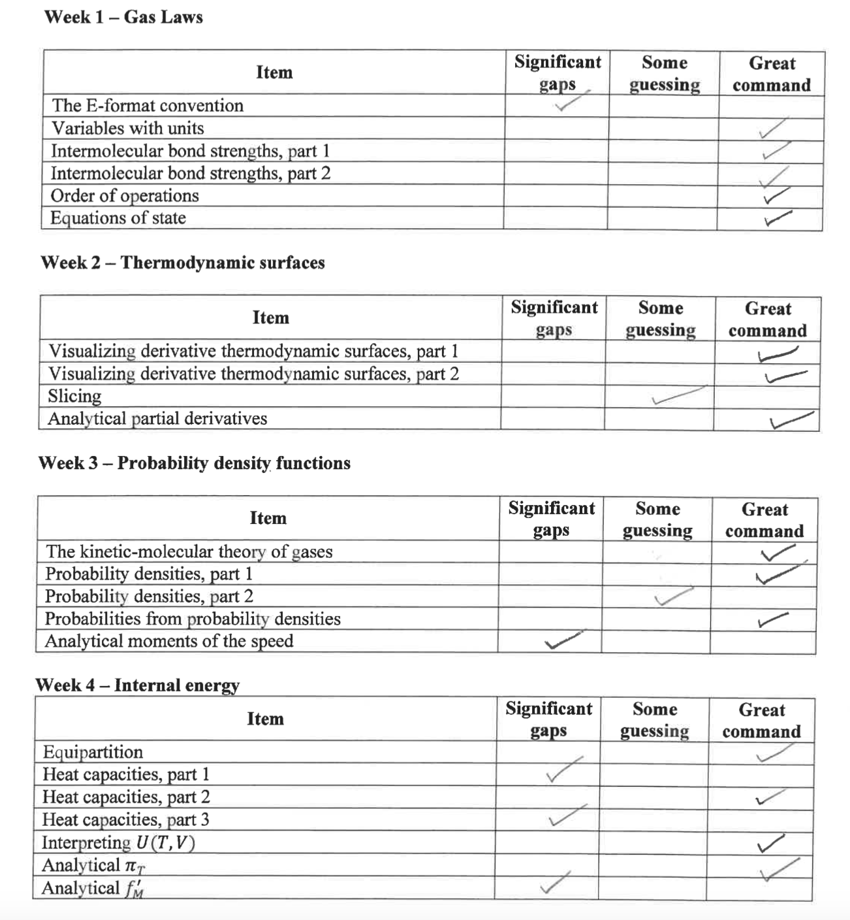
Scoring the 1-on-1 interviews

